Slide 1
Watershed Properties
Keerthy Raaj Shanmugam
October 4, 2021

Slide 2
Story Elements
01. Introduction
02.Recomendation
03. Rationale Explanation for the recommendation
04. Forecast
05. Implications of the Sensitivity Analysis

Slide 3
Story Elements
06. Visualization
07. Closing

Slide 4

01. Introduction
Watershed Properties is the Real estate company, and its current focus is on long term rentals. Moreover, the company want to expand its domain into short term rentals, and want to increase the profit and reduce the risk.

Slide 5
02.Recomendation
The recommendation for Watershed Property is to enter the short-term rental properties. There are risks in starting that but it can produce a great income. Moreover, there are a plethora of ways to reduce the risk and increase the profit. The investments will be high for starting the short-term rentals but we can get good turnover as of the high investments.

Slide 6
03. Rationale Explanation for the recommendation
Entering the short-term rental will be the recommendation for the Watershed Properties and profit from the short-term rental is the rationale explanation. Moreover, we can easily reduce the risk and increase the profit as Watershed Properties have experience n the long-term rental properties.

Slide 7
04. Forecast
Watershed Properties will get profit from around 30 properties in different locations in United States of America. Moreover, the profits are around 20k dollars. And the risk associated with it is as same as long-term rentals and so we can easily reduce the risk and further increase the profit in the upcoming years.

Slide 8
05. Implications of the Sensitivity Analysis
Implications of the Sensitivity Analysis is the risk associated with the short-term property, And the risks are easily handled by Watershed Properties as it has experience in handling it.
Risks can be easily handled and so Watershed Properties can focus on improving the profit in upcoming years.

Slide 9
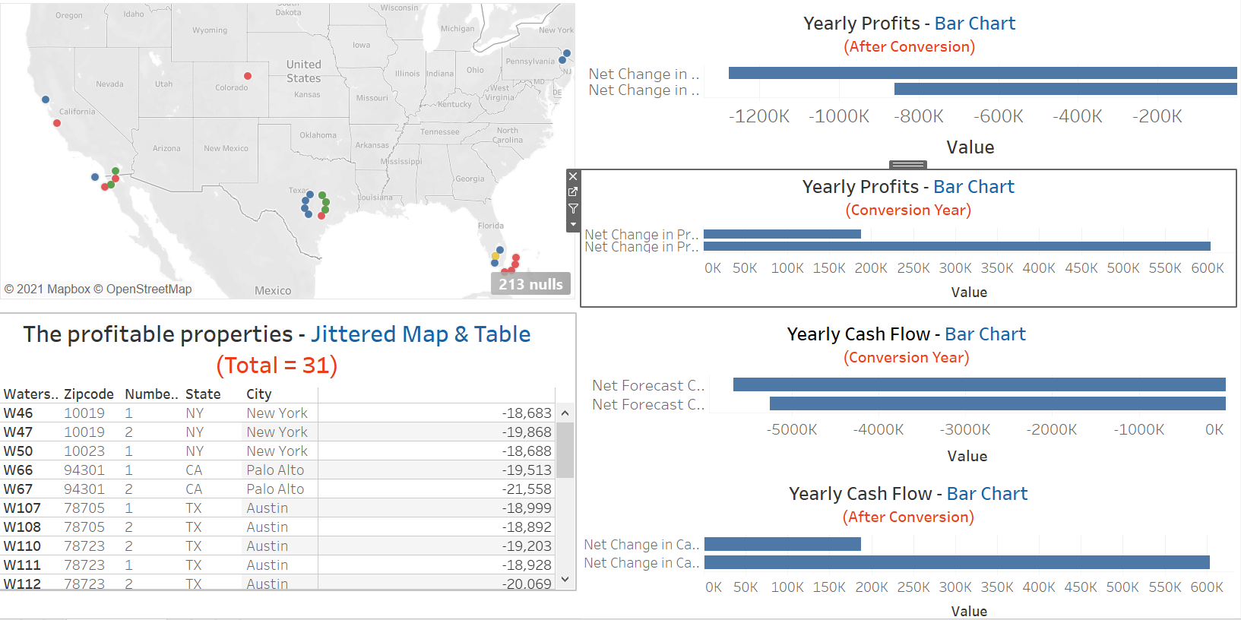
06. Visualization - Dashboard

Slide 10
07. Closing
Watershed Property should enter the Short-term Rentals as it will bring a plethora of profit.

Slide 11

Thank You!

